Slide 1
(U) MATLAB Tools – CFAR Processor
Jeff Hole

Slide 2
Current Capabilities
1-dimensional CFAR
Arbitrary number of training cells and guard cells for both sides of the cell-under-test (CUT)
A signal matrix can be input (NxM) and an argument specifying which dimension to apply the CFAR across
Utilizes vectorized MATLAB features for fast operation
2-dimensional CFAR
Arbitrary number of training cells in both dimensions for number of training cells and guard cells.
Currently limited to centered CUT in both dimensions

Slide 3
Things To Add/Explore
Independent variance measures on left and right side training cells
Weight sides differently based on relative magnitude (small feature extraction might perform better)

Slide 4
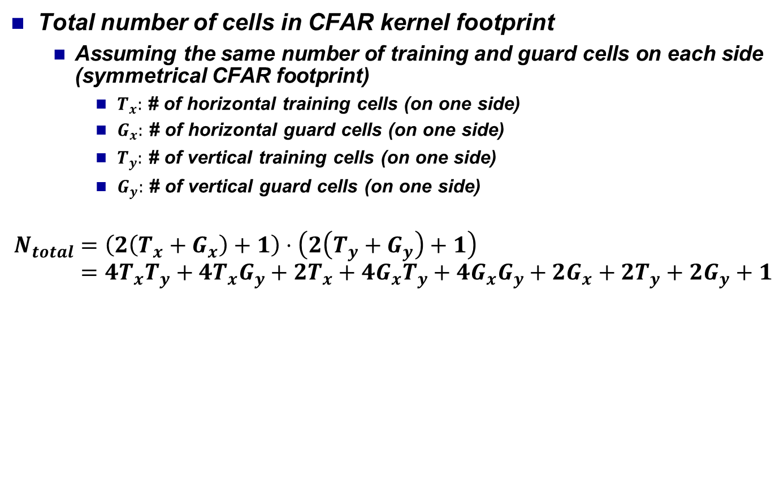
Some Mathematical Relationships 2-D CFAR
Total number of cells in CFAR kernel footprint
Assuming the same number of training and guard cells on each side (symmetrical CFAR footprint)
$T_{x}:$ # of horizontal training cells (on one side)
$G_{x}:$ # of horizontal guard cells (on one side)
$T_{y}:$ # of vertical training cells (on one side)
$G_{y}:$ # of vertical guard cells (on one side)
$$N_{total}=\left(2\left(T_{x}+G_{x}\right)+1\right)⋅\left(2\left(T_{y}+G_{y}\right)+1\right) \\ =4T_{x}T_{y}+4T_{x}G_{y}+2T_{x}+4G_{x}T_{y}+4G_{x}G_{y}+2G_{x}+2T_{y}+2G_{y}+1$$
+1 is for the cell-under-test, which contributes to the overall footprint area

Slide 5
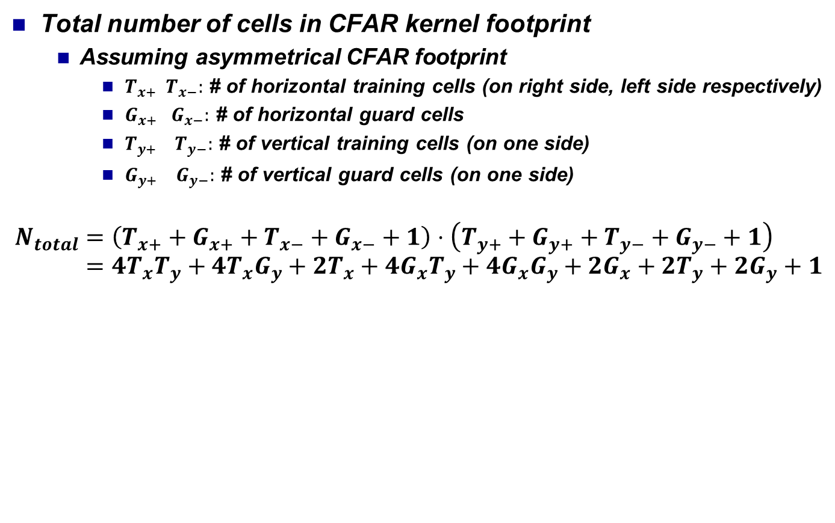
Some Mathematical Relationships 2-D CFAR
Total number of cells in CFAR kernel footprint
Assuming asymmetrical CFAR footprint
$T_{x+} T_{x−}:$ # of horizontal training cells (on right side, left side respectively)
$G_{x+} G_{x−}:$ # of horizontal guard cells
$T_{y+} T_{y−}:$ # of vertical training cells (on one side)
$G_{y+} G_{y−}:$ # of vertical guard cells (on one side)
$$N_{total}=\left(T_{x+}+G_{x+}+T_{x−}+G_{x−}+1\right)⋅\left(T_{y+}+G_{y+}+T_{y−}+G_{y−}+1\right) \\ =4T_{x}T_{y}+4T_{x}G_{y}+2T_{x}+4G_{x}T_{y}+4G_{x}G_{y}+2G_{x}+2T_{y}+2G_{y}+1$$
+1 is for the cell-under-test, which contributes to the overall footprint area

Slide 6
Edge/Border Cases
The default operation is to calculate the number of active averaging cells at each cell-under-test (CUT).
This can be accomplished in a single line of code:
normFactors = conv2(ones(size(signal)), cfar_kernel, ‘same’);
Using this, we can run the one liner:
cfar = threshold * conv2(signal, cfar_kernel, ‘same’) ./ normFactors;

